Slide 1
Advanced Process Scheduling
Modern processors contain multiple CPU cores.
The operating system scheduler must decide which process/thread runs on which core.
Goals:
  Maximize CPU utilization
  Reduce response time
  Improve throughput
  Maintain fairness
Challenges:
  Load imbalance
  Cache coherence overhead
  Memory access latency
Notes:
Introduce the module, importance in modern multi-core and distributed systems.

Slide 2
Multi-core Scheduling
Multiple CPU cores available
Challenges:
  Load imbalance
  Cache coherence
  Memory access latency
Notes:
Discuss challenges like cache sharing and load imbalance.

Slide 3
Processor Affinity-Based Scheduling
Processor affinity means binding a process to a specific CPU core.
Types:
  Soft Affinity: OS tries to keep process on same core
  Hard Affinity: Process is forced to run on a fixed core
Advantages:
  Better cache locality
  Reduced cache misses
  Improved performance
Example: If Process P runs on Core 1 repeatedly, its data remains in cache → faster execution.
Notes:
Explain why scheduling is critical for performance and fairness.

Slide 4
Processor Affinity-Based Scheduling
Problems without affinity
  Threads migrate between cores
  Cache contents are lost → cache misses
  NUMA systems may cause remote memory access
Real Time System Usage
  Linux: taskset -c 2 myprogram
  Windows: SetProcessAffinityMask()
Notes:
Explain why scheduling is critical for performance and fairness.

Slide 5
When Processor Affinity Should Be Used
Real-time applications
High-performance computing
Database servers
Multimedia processing
NUMA systems

Slide 6
When process Affinity not to be used
General-purpose workloads
Systems with uneven load
When flexibility is needed for load balancing

Slide 7
Load Balancing
Distributes workload evenly across cores
Types:
  Static load balancing
  Dynamic load balancing
Goal:
  Avoid idle CPUs while others are overloaded
Notes:
Explain how OS balances workload across cores.

Slide 8
Static Load Balancing
Description
Decisions made before execution
No runtime migration
Techniques
Round Robin Assignment
Compile-time partitioning
Example
4 cores, 8 tasks
Each core gets 2 tasks permanently
Pros
Low overhead
Cons
Cannot adapt to workload changes
Notes:
Explain how OS balances workload across cores.

Slide 9
Dynamic Load balancing
Description
Tasks are redistributed at runtime
Uses task migration
Load balancing techniques distribute workload across processors to maximize utilization while minimizing migration and memory access cost.

Slide 10
Dynamic Load balancing
Core | Load
C0 | 90%
C1 | 85%
C2 | 20%
C3 | 15%
Push Migration: Scheduler moves tasks from C0 → C2
Pull Migration: Core C3 is idle.It steals a task from C1
Centralized Load Balancing: One global scheduler decides task placement
Distributed Load Balancing: Each CPU has its own run queue,Periodic balancing
NUMA-Aware Load Balancing: Balances load within NUMA node first, Avoids remote memory access
Energy-Aware Load Balancing: Balances performance vs power consumption
Real-Time Load Balancing: Ensures deadlines are met

Slide 11
Cache & Memory Optimization
Cache locality improves performance
Cache locality refers to the principle that programs tend to access the same data or nearby data repeatedly over a short period of time
Scheduling considers:
  L1/L2/L3 cache usage
  Memory hierarchy
Reduces cache misses and memory latency
Notes:
Explain cache hierarchy and scheduling decisions.

Slide 12
Types of Cache Locality
Temporal Locality
If a data item is accessed once, it is likely to be accessed again soon.
Example:
for(i=0;i<100;i++)
sum += a; // variable 'a' accessed repeatedly
Spatial Locality
If a memory location is accessed, nearby memory locations are likely to be accessed next.
Example:
int arr[100];
for(i=0;i<100;i++)
arr[i] = i; // contiguous memory access

Slide 13
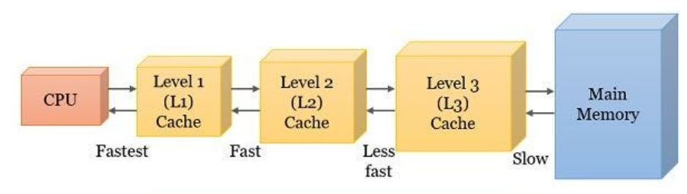
Cache Levels: L1, L2, L3
Cache Level | Location | Speed | Size | Used By
L1 | Inside each core | Fastest | Small | One core
L2 | Per core or shared | Fast | Medium | One/few core
L3 | Shared among cores | Slower than l2 | Large | All Cores
Scheduler must consider which cache levels will be reused when scheduling processes/threads.

Slide 14
Why Cache Locality Improves Performance
Without Cache Awareness:
Process A runs → cache filled with A’s data
Process B runs → cache flushed → new data loaded
Process A runs again → cache miss → slow memory access
With Cache Awareness:
Process A continues running
Cache already contains required data
Fewer cache misses
Lower memory latency
Higher CPU utilization

Slide 15
Cache Miss and Memory Latency
Cache Miss
Occurs when required data is not found in cache, so CPU must fetch it from:
L2 → L3 → RAM (slow)
Memory Latency
Time taken to access data from memory
Cache miss ⇒ high latency ⇒ CPU stalls
Goal of scheduling:
Minimize cache misses and memory access latency

Slide 16
Role of CPU Scheduling in Cache Locality
Modern schedulers are cache-aware, not just time-sharing.
Scheduling Considers:
Which process was running previously
Which core’s cache contains relevant data
Avoids unnecessary cache invalidation

Slide 17
Scheduling Techniques That Improve Cache Locality
Processor Affinity (CPU Affinity)
A process is scheduled on the same CPU core repeatedly
Increases reuse of L1 and L2 cache
Cache-Aware Load Balancing
Scheduler avoids moving processes across cores unnecessarily
Moving a process → cache warm-up cost
Thread Scheduling
Threads of the same process share Code and Data
Scheduling them close in time improves L3 cache usage
Memory Hierarchy Awareness
Schedulers consider the full memory hierarchy:
Registers ↓ L1 Cache ↓ L2 Cache ↓ L3 Cache ↓ Main Memory (RAM) ↓ Disk
Access time increases as we go down the hierarchy.

Slide 18
Key Benefits of Cache-Aware Scheduling
Reduced cache misses
Lower memory latency
Faster program execution
Better CPU throughput
Improved system responsiveness

Slide 19
NUMA-aware Scheduling
NUMA (Non-Uniform Memory Access) systems
Memory access time depends on memory location
NUMA-aware scheduler:
  Schedules process near its memory
  Improves performance and scalability
Notes:
Explain NUMA architecture with an example.

Slide 20
What is NUMA
NUMA (Non-Uniform Memory Access) is a memory architecture used in multi-processor / multi-core systems where:
  Each CPU (or group of cores) has its own local memory
  Access time to local memory is fast
  Access time to remote memory (other CPU’s memory) is slower
Memory access time is non-uniform, hence the name NUMA.

Slide 21
NUMA vs UMA
Feature | UMA | NUMA
Memory access time | Uniform | Non-uniform
Memory location | Single shared memory | Distributed memory nodes
Scalability | Limited | Highly scalable
Example systems | Small SMP systems | Modern servers, data centers

Slide 22
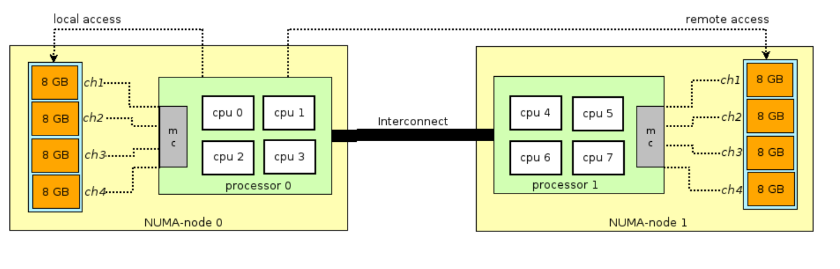
NUMA ARCHITECTURE

Slide 23
What is NUMA-Aware Scheduling?
NUMA-aware scheduling means the OS scheduler schedules a process on the CPU closest to the memory it uses most
Goal:
  Minimize remote memory access
  Maximize local memory access
  Improve performance and scalability

Slide 24
Why NUMA-Aware Scheduling is Needed
Without NUMA Awareness:
  Process runs on CPU 0
  Data stored in Memory 1
  Every memory access crosses interconnect
  High latency + low throughput
With NUMA Awareness:
  Process runs on CPU 1
  Data in Memory 1
  Local access → fast execution

Slide 25
Key Concepts in NUMA-Aware Scheduling
a) NUMA Nodes
  A NUMA node = CPU(s) + local memory
  System is divided into multiple nodes
b) Memory Affinity
  Relationship between a process and its memory location
  Process performs best near its memory
c) CPU Affinity vs NUMA Affinity
  TypeMeaningCPU affinityBind process to CPU/coreNUMA affinityBind process to NUMA node
  NUMA affinity is higher level and more important in large systems.

Slide 26
How OS Scheduler Becomes NUMA-Aware
Step-by-Step:
OS tracks:
  Where process memory pages are allocated
Scheduler detects:
  Which NUMA node the process mostly accesses
Process scheduled on:
  CPU cores within the same NUMA node

Slide 27
Memory Placement Policies
a) First-Touch Policy
  Memory page allocated on NUMA node of CPU that first accesses it
  Common in Linux
  Example:
  Thread runs on Node 0
  First writes to memory
  Memory placed on Node 0
b) Interleaving
  Memory pages distributed across NUMA nodes
  Used for bandwidth-heavy workloads
c) Preferred Node
  Application prefers one NUMA node
  OS tries to allocate memory there

Slide 28
Process Migration in NUMA Systems
Bad Migration:
  Process moved to another NUMA node
  Memory stays in original node
  Causes remote memory access
NUMA-Aware Migration:
Either:
  Avoid migration
  Or migrate memory pages along with process

Slide 29
Benefits of NUMA-Aware Scheduling
Reduced remote memory access
Lower memory latency
Better cache utilization
Higher throughput
Improved scalability for servers

Slide 30
Real-World Use Cases
Cloud computing
Databases (Oracle, MySQL)
Big data platforms (Hadoop, Spark)
Virtual machines & containers

Slide 31
Thread Libraries
A thread is the smallest unit of CPU execution within a process.
A process can have multiple threads that share:
  Code
  Data
  Files
  but each thread has its own stack and registers.
User-level threads are managed entirely by a user-level library, without the kernel’s awareness.
  The OS sees only one process, even if it contains many threads.
  Thread creation, scheduling, and management are done in user space
  Kernel is not involved in thread operations
Kernel-level threads are managed directly by the operating system kernel.
The OS knows about each thread and schedules them individually.
Kernel handles creation, scheduling, and synchronization
Each thread can run on different CPU cores
Notes:
Explain user-level vs kernel-level threads.

Slide 32
Thread Libraries
Thread libraries provide API for thread management
Examples:
  POSIX Threads (Pthreads)
  Windows Threads
Notes:
Explain user-level vs kernel-level threads.

Slide 33
Real-Time Synchronization
Used in time-critical systems
Ensures predictable execution
Key mechanisms:
  Semaphores
  Condition variables
Notes:
Explain importance in real-time systems.

Slide 34
Synchronization is the mechanism that ensures:
  Correct ordering of execution
  Safe access to shared resources
  Predictable timing behavior
In real-time systems, synchronization must satisfy:
  Correctness
  Bounded blocking time
  Predictability
Missing deadlines can cause system failure.

Slide 35
Why Synchronization is Critical in Real-Time Systems
Real-time tasks often:
  Share hardware resources (I/O devices, buffers)
  Share data structures
  Run with priorities
Problems without proper synchronization:
  Race conditions
  Deadlocks
  Priority inversion
  Missed deadlines

Slide 36
Semaphores
A semaphore is an integer variable used in mutual exclusive manner to control access to shared resources using two atomic operations:
wait() / P() / down()
signal() / V() / up()
Types:
  Binary semaphore
  Counting semaphore
Operations:
  wait()
  signal()
Notes:
Explain wait() and signal() operations.

Slide 37
Semaphore operations
wait(S):
if S > 0 → S = S − 1
else → block task
signal(S):
S = S + 1
if tasks blocked (s<=0)→ wake one

Slide 38
Semaphores
Problems with Semaphores in Real-Time
Unbounded blocking
Priority inversion
Deadlock possibility
Hard to debug

Slide 39
Condition Variables
Used with mutex locks
Allows threads to wait for conditions
Producer–Consumer Using Condition Variables
Condition Variables Used
  not_full
  not_empty
  mutex
Notes:
Explain producer-consumer example.

Slide 40
Explanation:
mutex lock;
  A mutual exclusion lock to ensure only one thread accesses the buffer at a time.
condition not_full;
  Condition variable that signals buffer is not full, allowing producer to insert.
condition not_empty;
  Condition variable that signals buffer is not empty, allowing consumer to remove.
buffer B;
  Shared data structure (like array or queue) used to store produced items.

Slide 41
Producer code
lock(mutex);//producer acquires the lock
while(buffer_full)//check if buffer is full
wait(not_full, mutex);//release the mutex and block the producer until not full is signalled
add_to_buffer(item);//add the produced item to buffer
signal(not_empty);//signals consumer that buffer is no longer empty
unlock(mutex);//release the lock

Slide 42
Consumer Code
lock(mutex);//acquire lock
while(buffer_empty)//check if buffer is empty
wait(not_empty, mutex);//Releases the mutex and blocks the consumer until not_empty
item = remove_from_buffer();//remove item from critical section
signal(not_full);//Signals producer that the buffer is no longer full, allowing it to produce more items.
unlock(mutex);//Consumer releases the lock so other threads can access the buffer.

Slide 43
Synchronization Protocols
Prevent priority inversion
Examples:
  Priority inheritance protocol
Idea
When a low-priority task blocks a higher-priority task, the low-priority task temporarily inherits the higher priority.
Example
Initial priorities:
H = 3 (highest)
M = 2
L = 1
L locks a mutex. H requests the mutex and blocks.
Under Priority Inheritance:
L's priority becomes 3
Now M can no longer preempt L.
Benefit: Prevents M from delaying H.
Notes:
Explain priority inversion problem.

Slide 44
Synchronization Protocols
2. Priority Ceiling Protocol (PCP)
Idea
Every shared resource is assigned a priority ceiling equal to the highest priority of any task that may use it.
Example:
Resource R used by H and L
H priority = 3
L priority = 1
Priority Ceiling of R = 3
When L locks R:
L immediately gets priority 3 even before H asks for the resource.
Benefit
Prevents priority inversion.
Also helps prevent certain deadlocks.

Slide 45
Adaptive Synchronization
Adjusts synchronization strategy at runtime
Depends on contention level and system state
Notes:
Explain why adaptive methods improve performance.

Slide 46
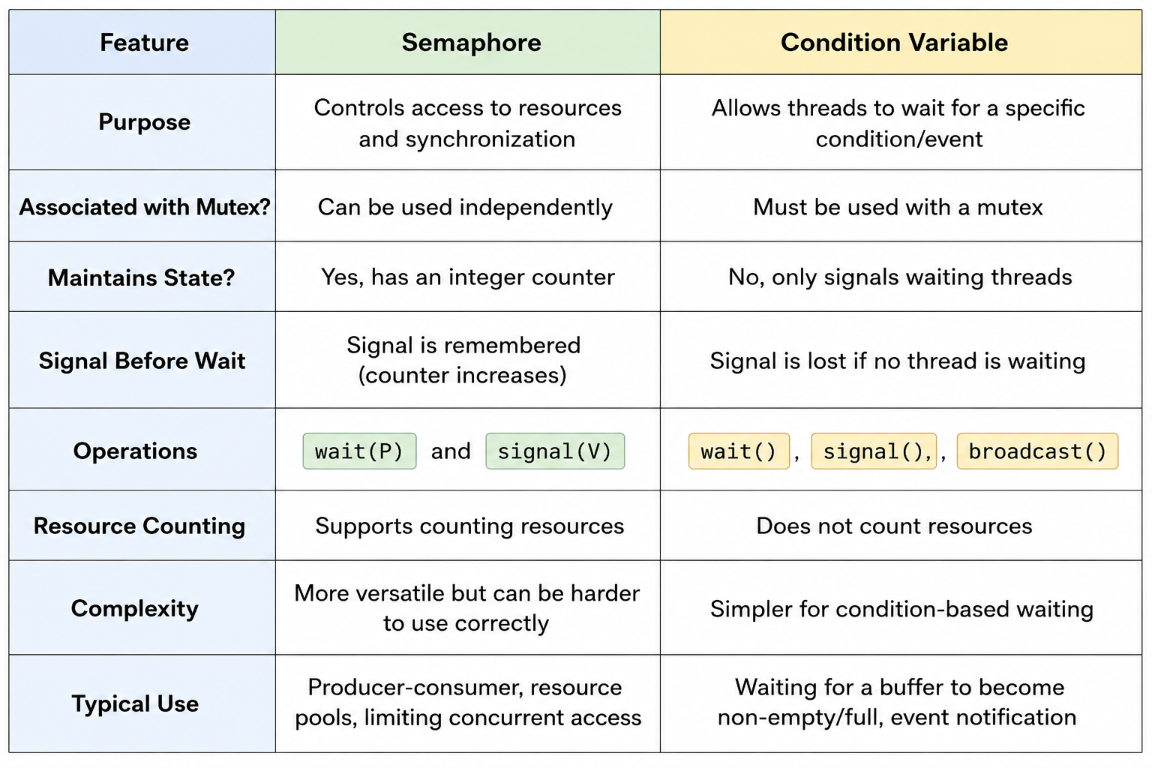
Semaphore-based Synchronization vs Condition Variable-based Synchronization

Slide 47
Semaphore-based Synchronization vs Condition Variable-based Synchronization
Both are used for coordinating multiple threads/processes, but they work differently and are suited to different situations.
Semaphore Example
Suppose there are 3 printers.
Semaphore printers = 3;
wait(printers); // acquire printer
// use printer
signal(printers); // release printer

Slide 48
Adaptive Locks
Switch between spinning and blocking
Benefits:
  Reduced overhead
  Better CPU utilization
Notes:
Explain spinlock vs mutex.

Slide 49
Lock-Free Data Structures
Avoid traditional locks
Use atomic operations (CAS) compare and swap
Advantages:
  No deadlock
  High concurrency
Notes:
Explain CAS and advantages.

Slide 50
Deadlock
A deadlock is a situation in an operating system where two or more processes are permanently blocked because each is waiting for a resource held by another.
Two people meet in a narrow bridge:
Person A won’t move until B moves
Person B won’t move until A moves
Both wait forever → deadlock

Slide 51
Deadlock
Classic OS example
Resources:
R1 (Printer)
R2 (Scanner)
Processes:
P1 holds R1 and requests R2
P2 holds R2 and requests R1
  P1 → R2 (wait)
  P2 → R1 (wait)
  Neither process can continue

Slide 52
Deadlock
The 4 necessary conditions for deadlock
Deadlock occurs only if all four hold simultaneously:
  Mutual Exclusion: Resource can be used by only one process at a time
  Hold and Wait: Process holds one resource while waiting for another
  No Preemption: Resources cannot be forcibly taken away
  Circular Wait: Circular chain of processes waiting for resources
Break any one → deadlock is prevented

Slide 53
Deadlock
Methods to handle deadlock
Deadlock Prevention
  Break one of the 4 conditions
  (e.g., avoid hold-and-wait)
Deadlock Avoidance
  Use Banker’s Algorithm
  Grant resources only if system stays in a safe state
Deadlock Detection & Recovery
  Detect deadlock, then:
  Kill a process
  Preempt resources
Ignore Deadlock
  Used by many OS (like Linux, Windows)
  “It rarely happens” approach

Slide 54
Centralized Deadlock Detection Algorithm
Some central nodes will coordinate activities between sites
Co-ordinator nodes is the union of all the other sites
If a cycle is found in the graph hence a deadlock
The co-ordinator will have to make the decision on which machine to notify for killing the process

Slide 55
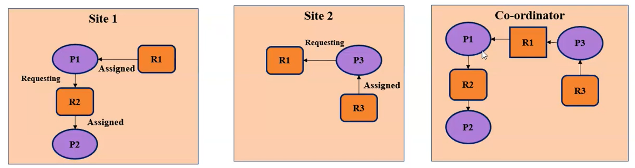
Centralized Deadlock Detection Algorithm

Slide 56
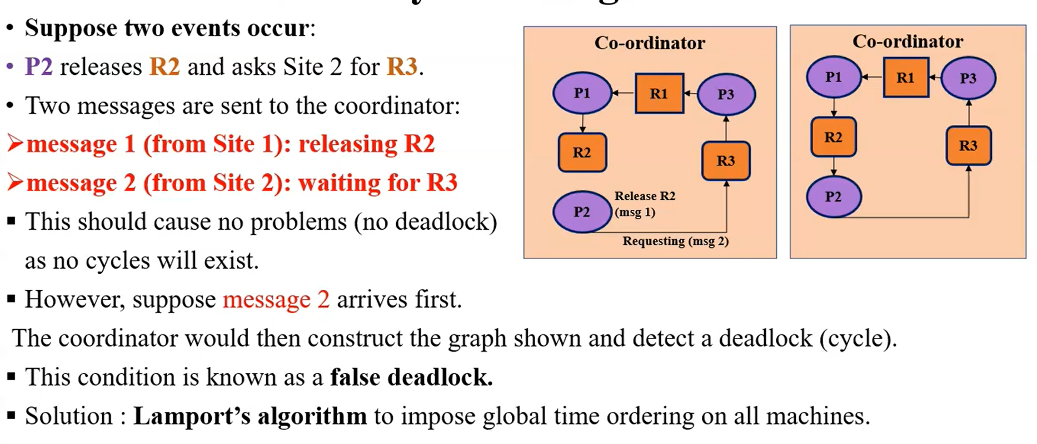
Solution after delayed message

Slide 57
Centralized Deadlock Detection Algorithm
Demerits
  One, single point of failure
  Communication bottleneck around the sites

Slide 58
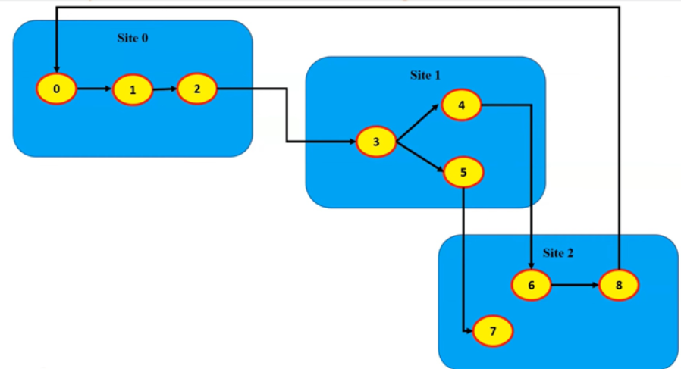
Chandy Misra Hass Distributed Deadlock Detection Algorithm

Slide 59
Chandy Misra Hass Distributed Deadlock Detection Algorithm
If a process make a request for a resource which fails or timeout, the process generates a probe message
Probe Message(#,#,#)
#- process id which initiated the probe message
#- Sender
#-Receiver

Slide 60
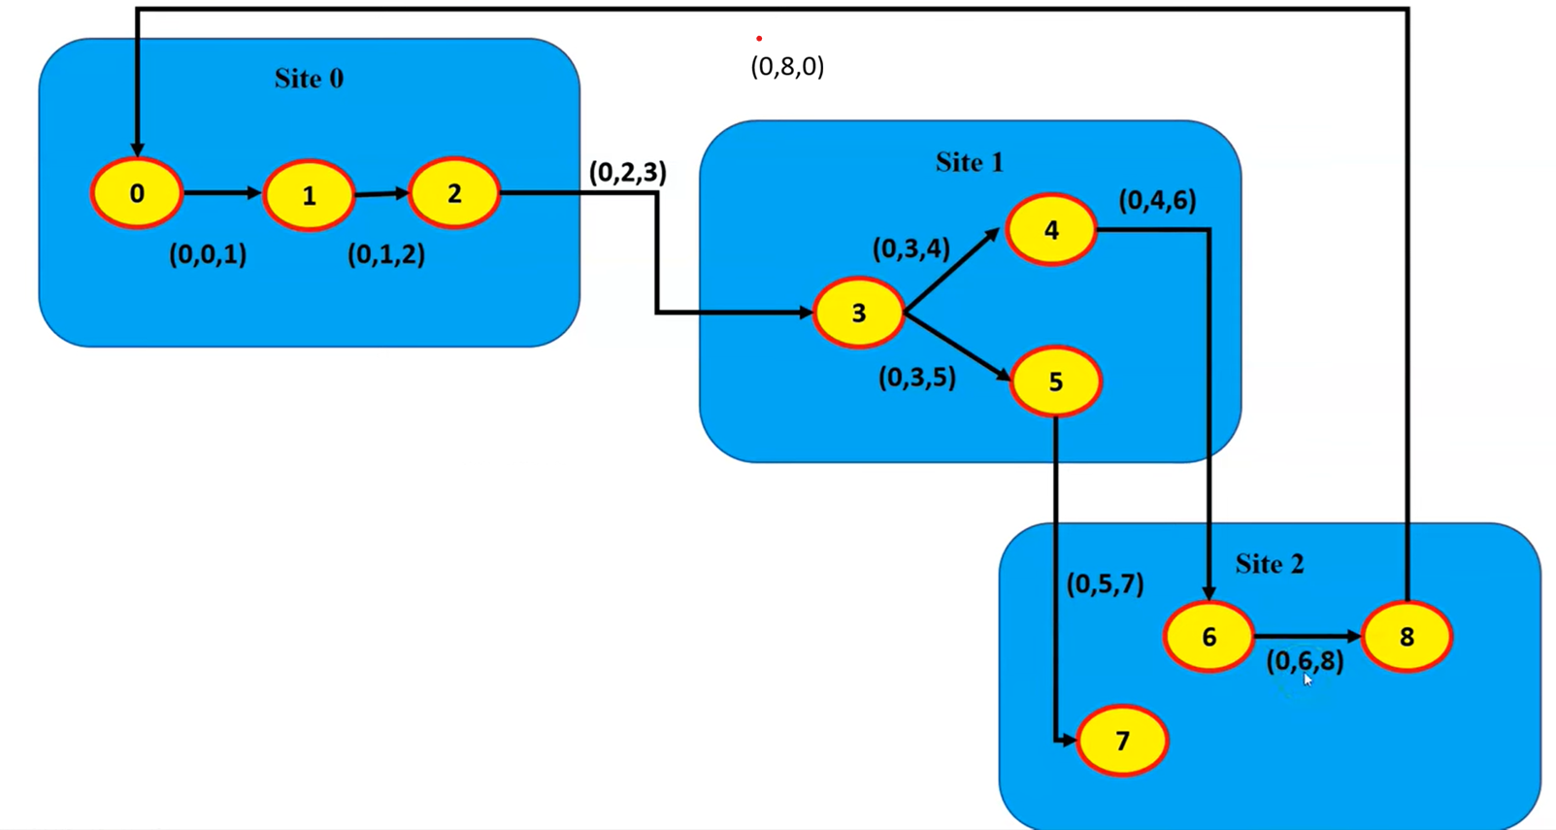
Chandy Misra Hass Distributed Deadlock Detection Algorithm

Slide 61
Chandy Misra Hass Distributed Deadlock Detection Algorithm
  The process that initiated the probe message commit suicide
  This method has problem if several process invoke the algorithm simultaneously

Slide 62
Hierarchial Deadlock Detection Algorithm
Combines centralized and distributed approaches
System is divided into clusters
Each cluster has a local coordinator
Coordinators form a hierarchy (tree structure)

Slide 63
Hierarchial Deadlock Detection Algorithm
Algorithm Steps
  Each cluster coordinator detects local deadlocks.
  If no local deadlock, it sends summary info to higher-level coordinator.
  Higher-level coordinator checks for inter-cluster deadlocks.
  Detection continues upward in the hierarchy.

Slide 64
Hierarchial Deadlock Detection Algorithm
Advantages
  Reduced communication overhead
  Scalable
  No single global bottleneck
Disadvantages
  Coordinator failure affects cluster
  More complex than centralized method

Slide 65
Distributed Mutual Exclusion Algorithms
Mutual Exclusion in Distributed Systems cannot be solved using Semaphores as it requires shared memory
An approach based on message passing is used to solve mutual exclusion problem
3 types of messages are used
  Request: sends permisson to all other sites to enter critical section
  Reply: message sent to requesting site to grant permission
  Release: while exiting the critical section

Slide 66
LAMPORT ALGORITHM
Permission based algorithm (and it is non token based algorithm).
Timestamp is used to order critical section requests and to resolve conflict between requests(Using Lamport Clock algorithm).
Three Types of messages :
1. REQUEST
2. REPLY
3. RELEASE
Every site (process) keeps a queue (RQ) to store critical section requests along with timestamp.
This algorithm requires communication channels to deliver messages the FIFO order.

Slide 67
LAMPORT ALGORITHM
RQ1={TS:1,P3}
RQ1={}
S1
Reply
Release
Request
RQ2={TS:1,P3}
RQ2={}
S2
Request
Reply
Release
S3
CR
RQ3={}
RQ3={TS:1,P3}
Accessing Critical Region

Slide 68
Accessing Critical Section
RQ1={TS:2,P1}
RQ1={TS:2,P1}
RQ1={TS:1,P3;
TS:2,P1}
S1
CS
RQ1={}
Reply
Reply
Reply
Release
Request
Release
Request
RQ2={TS:1,P3;
TS:2,P1}
S2
RQ2={TS:1,P3}
RQ2={TS:2,P1}
Release
RQ2={}
Request
Request
Release
Reply
S3
CS
RQ3={TS:1,P3;
TS:2,P1}
RQ3={TS:2,P1}
RQ3={}
RQ3={TS:1,P3}

Slide 69
LAMPORT ALGORITHM
Requesting the critical section
When a site Si wants to enter the CS, it broadcasts a REQUEST(tsi , i) message to all other sites and places the request on RQi(tsi , i).
When a site Sj receives the REQUEST(tsi , i) message from site Si ,places site Si request on RQj and it returns a timestamped REPLY message to Si .
Executing the critical section
Site Si enters the CS when the following two conditions hold:
L1: Si has received a message with timestamp larger than (tsi , i) from all other sites.
L2: Si ’s request is at the top of request RQi .

Slide 70
LAMPORT ALGORITHM
Releasing the critical section:
Site Si, upon exiting the CS, removes its request from the top of its RQi and broadcasts a timestamped RELEASE message to all other sites.
When a site Sj receives a RELEASE message from site Si , it removes Si’s request from its RQj.

Slide 71
correctness arguments
Lamport’s algorithm achieves mutual exclusion:
Proof is by contradiction. Two sites Si and Sj are executing the CS concurrently. For this to happen conditions L1 and L2 must hold at both the sites concurrently.
At some instant in time, both Si and Sj have their own requests at the top of their RQs and condition L1 holds at them. (Si’s has smaller timestamp than Sj)
From condition L1 and FIFO property of the communication channels, it is clear that at instant t the request of Si must be present in RQj when Sj was executing its CS. This implies that Sj’s own request is at the top of its own RQ when a smaller timestamp request, Si’s request, is present in the RQi – a contradiction!
SOURCE : https://www.cs.uic.edu/~ajayk/Chapter9.pdf

Slide 72
Safety
RQi={TS:1,i;
TS:2,j}
Si
Sj
RQj={TS:2,j;
TS:1,i}
CS
Sj
Sj in CS but Si have lower TS
CONTRADICTION!!!!
TSi < TSj
L1: Si has received a message with timestamp larger than (tsi , i) from all other sites
L2: Si ’s request is at the top of request RQi

Slide 73
correctness arguments
Liveness: if process made a request to access the critical section should eventually get chance to access the critical section.
Fairness: Critical Section request are executed in order they generated.

Slide 74
correctness arguments
Liveliness and Fairness :
Suppose a site Si ’s request has a smaller timestamp than the request of another site Sj and Sj is able to execute the CS before Si .
For Sj to execute the CS, it has to satisfy the conditions L1 and L2. This implies that, Sj has its own request at the top of its queue and it has also received a message with timestamp larger than the timestamp of its request from all other sites.
But request queue at a site is ordered by timestamp, and according to our assumption Si has lower timestamp. So Si ’s request must be placed ahead of the Sj ’s request in the request RQj . This is a contradiction!
SOURCE : https://www.cs.uic.edu/~ajayk/Chapter9.pdf

Slide 75
Liveness and Fairness
RQi={}
RQj={}
RQi={TS:2,j}
RQj={TS:2,j}
RQi={TS:1,i;
TS:2,j}
Si
Sj
RQj={TS:2,j;
TS:1,i}
CS
Si
TSi < TSj
Sj
L1: Si has received a message with timestamp larger than (tsi , i) from all other sites
L2: Si ’s request is at the top of request RQi

Slide 76
cost of the protocol
For each CS execution, Lamport’s algorithm requires (N − 1) REQUEST messages, (N − 1) REPLY messages, and (N − 1) RELEASE messages.
Thus, Lamport’s algorithm requires 3(N − 1) messages per CS invocation.
Algorithm can be optimized to 2(N – 1) messages by omitting the REPLY message.

Slide 77
Drawbacks of Lamport’s Algorithm
Unreliable approach: failure of any one of the processes will halt the progress of entire system.
High message complexity: Algorithm requires 3(N-1) messages per critical section invocation.

Slide 78
REFERENCES
https://www.cs.uic.edu/~ajayk/Chapter9.pdf
https://www.geeksforgeeks.org/lamports-algorithm-for-mutual-exclusion-in-distributed-system
https://www.cs.fsu.edu/~xyuan/cop5611/lecture8.html

Slide 79
Ricart Agarwala Mutual Exclusion Algorithm
Ricart–Agrawala algorithm is an algorithm for mutual exclusion in a distributed system proposed by Glenn Ricart and Ashok Agrawala.
This algorithm is an extension and optimization of Lamport's Distributed Mutual Exclusion Algorithm.
Like Lamport's Algorithm, it also follows permission-based approach to ensure mutual exclusion.

Slide 80
Ricart Agarwala Mutual Exclusion Algorithm
Two type of messages ( REQUEST and REPLY) are used and communication channels are assumed to follow FIFO order.
A site send a REQUEST message to all other site to get their permission to enter the critical section.
A site send a REPLY message to another site to give its permission to enter the critical section.
A timestamp is given to each critical section request using Lamport's logical clock.
Timestamp is used to determine priority of critical section requests. Smaller timestamp gets high priority over larger timestamp. The execution of critical section request is always in the order of their timestamp.

Slide 81
Ricart Agarwala Mutual Exclusion Algorithm
Algorithm:
  To enter Critical section:
    When a site S_{i} wants to enter the critical section, it send a timestamped REQUEST message to all other sites.
    When a site S_{j} receives a REQUEST message from site S_{i}, It sends a REPLY message to site S_{i} if and only if
      Site S_{j} is neither requesting nor currently executing the critical section.
      In case Site S_{j} is requesting, the timestamp of Site S_{i}'s request is smaller than its own request.

Slide 82
Ricart Agarwala Mutual Exclusion Algorithm
To execute the critical section:
  Site S_{i} enters the critical section if it has received the REPLY message from all other sites.
To release the critical section:
  Upon exiting site S_{i} sends REPLY message to all the deferred requests.

Slide 83
Ricart Agarwala Mutual Exclusion Algorithm
Message Complexity: Ricart–Agrawala algorithm requires invocation of 2(N - 1) messages per critical section execution. These 2(N - 1) messages involves
(N - 1) request messages
(N - 1) reply messages

Slide 84
Ricart Agarwala Mutual Exclusion Algorithm
Drawbacks of Ricart–Agrawala algorithm:
Unreliable approach: failure of any one of node in the system can halt the progress of the system. In this situation, the process will starve forever. The problem of failure of node can be solved by detecting failure after some timeout.

Slide 85
Maekewas Algorithm
Maekawa’s algorithm is used for distributed mutual exclusion, and the key idea is how to select quorums so that no two processes can enter the critical section at the same time.

Slide 86
Maekewas Algorithm
What is a quorum in Maekawa’s algorithm?
  Simple definition
  A quorum is a subset of processes from which a process must obtain permission before entering the critical section.
  Each process has its own quorum.

Slide 87
Maekewas Algorithm
Why do we need quorums?
  In distributed systems:
  Asking all processes for permission is expensive
  Maekawa reduces messages by asking only a subset
  But quorums must be chosen carefully to maintain mutual exclusion.

Slide 88
Maekewas Algorithm
Rules for selecting quorums (VERY IMPORTANT)
  For Maekawa’s algorithm, quorums must satisfy:
    Rule 1: Intersection property
    Any two quorums must have at least one common process
    This ensures mutual exclusion
    (because that common process cannot grant permission to both at the same time)
    Rule 2: Self-inclusion
    A process must be a member of its own quorum
    Rule 3: Equal size (preferred)
    All quorums should be of approximately equal size
    This improves fairness and performance.

Slide 89
Maekewas Algorithm
How to select quorums (Step-by-Step Method)
  Step 1: Arrange processes in a √N × √N grid
  Example:
  Let N = 9
P1 P2 P3
P4 P5 P6
P7 P8 P9
Step 2: Define quorum for each process
  A common method:
  Quorum = all processes in the same row + same column

Slide 90
Maekewas Algorithm
How quorum is used in Maekawa’s algorithm
When process Pi wants to enter critical section:
Pi sends REQUEST to all members of its quorum
Each quorum member grants permission to only one process at a time
Pi enters CS only after receiving all replies
On exit, Pi sends RELEASE to quorum members

Slide 91
Maekewas Algorithm
Advantages of this quorum selection
  Fewer messages
  Scalable
  No central coordinator
  Mutual exclusion guaranteed
Limitations
  Deadlock possible (needs extra handling)
  Quorum construction not trivial for arbitrary N
  Starvation possible

Slide 92
Assignment–2: Comparative Study (Analytical)
Q1. Create a comparison table between Linux and Windows process management based on:
  Process creation
  Scheduling approach
  Process states
  Priority handling
  Inter-process communication
Q2.Explain Linux Completely Fair Scheduler (CFS).
How does it ensure fairness among processes?
Q3.Explain Windows priority-based preemptive scheduling.
What are priority classes and priority levels?
Q4.Discuss how multithreading is implemented in:
  Linux (lightweight processes)
  Windows (threads as basic scheduling unit)

